Slide 1
1. 双曲函数
典型的双曲函数及特性如下：
（1） ，
（2） ；当且仅当 时，
（3） ， ；当且仅当
时， 。
（4） 为单调递增函数。

Slide 2
引理1：如下动态系统全局渐近稳定：
其中 。
证明：考虑函数 和 。 定义

Slide 3
则
令 ， ，则 ，

Slide 4
由于 ,则 ，从
而 ，且当且仅当 时， 。因此系统渐近稳定，且当 时， ， 。
又因为
于是

Slide 5
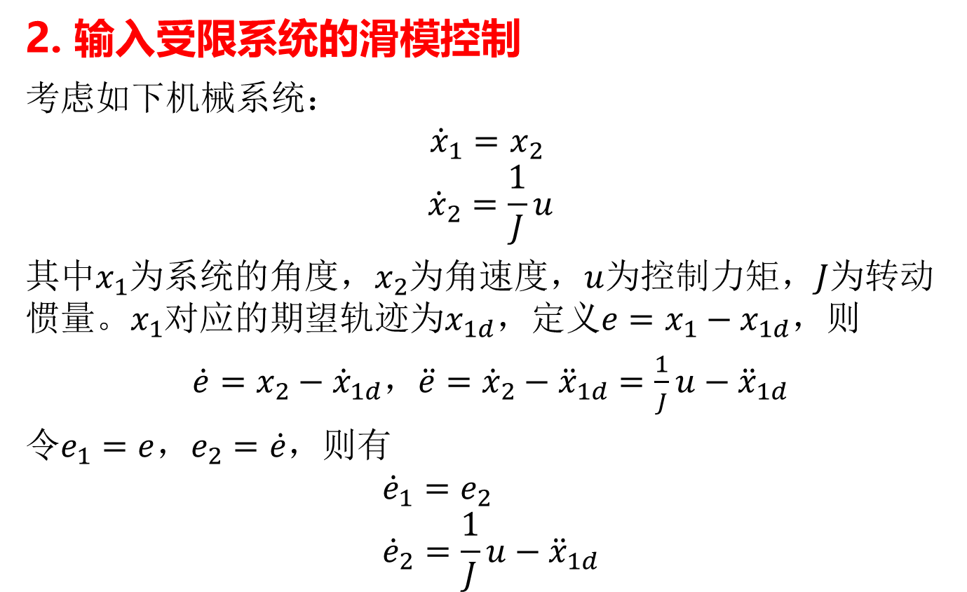
2. 输入受限系统的滑模控制
考虑如下机械系统：
$${\dot{x}}_{1}=x_{2}$$
$${\dot{x}}_{2}=\frac{1}{J}u$$
其中$x_{1}$为系统的角度，$x_{2}$为角速度，$u$为控制力矩，$J$为转动惯量。$x_{1}$对应的期望轨迹为$x_{1d}$，定义$e=x_{1}−x_{1d}$，则
$\dot{e}=x_{2}−{\dot{x}}_{1d}$，$\ddot{e}={\dot{x}}_{2}−{\ddot{x}}_{1d}=\frac{1}{J}u−{\ddot{x}}_{1d}$
令$e_{1}=e$，$e_{2}=\dot{e}$，则有
$${\dot{e}}_{1}=e_{2} \\ {\dot{e}}_{2}=\frac{1}{J}u−{\ddot{x}}_{1d}$$

Slide 6
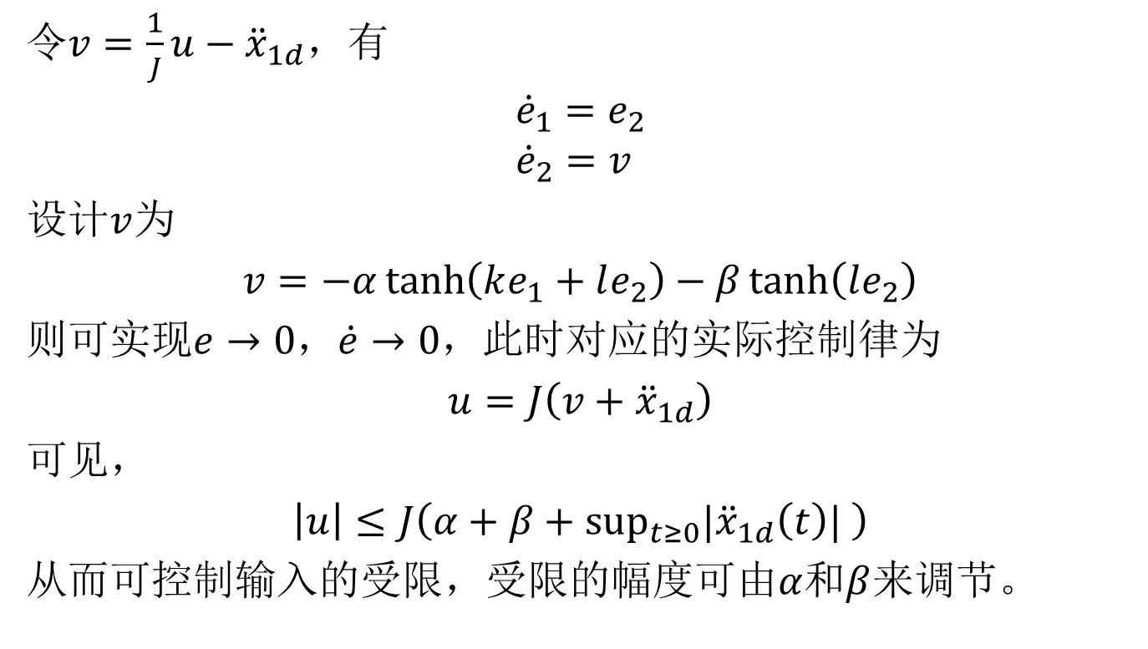
令$v=\frac{1}{J}u−{\ddot{x}}_{1d}$，有
$${\dot{e}}_{1}=e_{2} \\ {\dot{e}}_{2}=v$$
设计$v$为
$v=−α\tanh\left(ke_{1}+le_{2}\right)−β\tanh\left(le_{2}\right)$
则可实现$e→0$，$\dot{e}→0$，此时对应的实际控制律为
$u=J\left(v+{\ddot{x}}_{1d}\right)$
可见，
$\left|u\right|≤J\left(α+β+\sup_{t≥0}{|\ddot{x}}_{1d}\left(t\right)| \right)$
从而可控制输入的受限，受限的幅度可由$α$和$β$来调节。

Slide 7
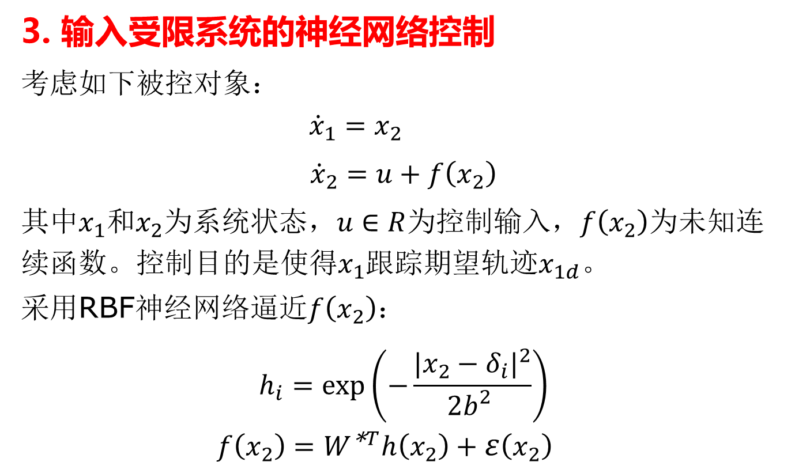
3. 输入受限系统的神经网络控制
考虑如下被控对象：
$${\dot{x}}_{1}=x_{2}$$
${\dot{x}}_{2}=u+f\left(x_{2}\right)$
其中$x_{1}和x_{2}为系统状态，u∈R$为控制输入，$f\left(x_{2}\right)$为未知连续函数。控制目的是使得$x_{1}$跟踪期望轨迹$x_{1d}。$
采用RBF神经网络逼近$f\left(x_{2}\right)$：
$$h_{i}=\exp\left(−\frac{{|x_{2}−δ_{i}|}^{2}}{2b_{}^{2}}\right)$$
$$f\left(x_{2}\right)=W^{\text{∗}T}h\left(x_{2}\right)+ε\left(x_{2}\right)$$

Slide 8
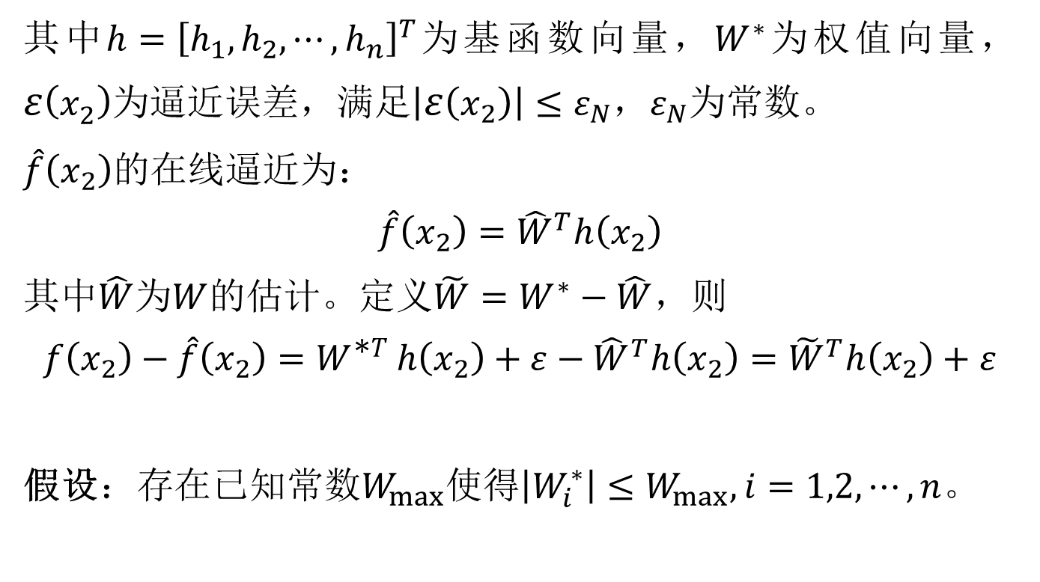
其中$h={\left[h_{1},h_{2},⋯,h_{n}\right]}^{T}$为基函数向量，$W^{∗}$为权值向量，$ε\left(x_{2}\right)$为逼近误差，满足$\left|ε\left(x_{2}\right)\right|≤ε_{N}$，$ε_{N}$为常数。
$\hat{f}\left(x_{2}\right)$的在线逼近为：
$$\hat{f}\left(x_{2}\right)={\hat{W}}^{T}h\left(x_{2}\right)$$
其中$\hat{W}$为$W$的估计。定义$\tilde{W}=W^{∗}−\hat{W}$，则
$$f\left(x_{2}\right)−\hat{f}\left(x_{2}\right)=W^{\text{∗}T}h\left(x_{2}\right)+ε−{\hat{W}}^{T}h\left(x_{2}\right)={\tilde{W}}^{T}h\left(x_{2}\right)+ε$$
假设$：存在已知常数W_{max}使得\left|W_{i}^{∗}\right|≤W_{max},i=1,2,⋯,n$。

Slide 9
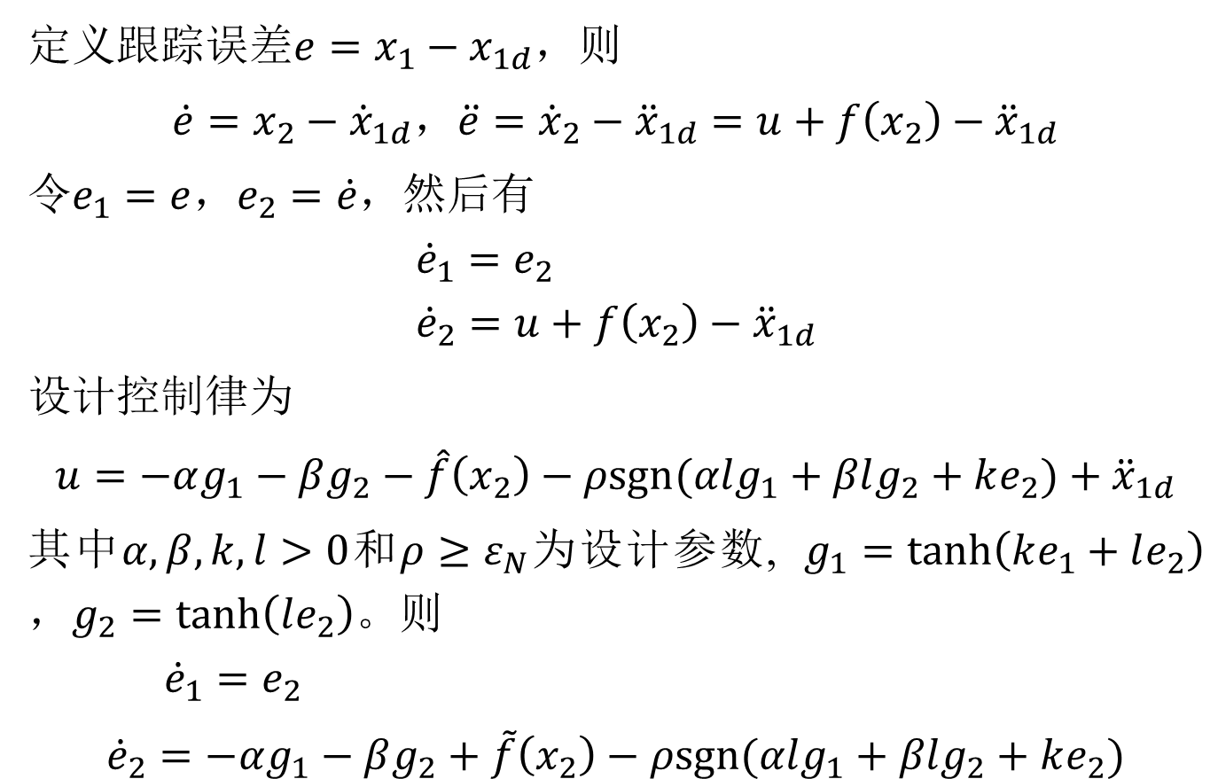
定义跟踪$误差e=x_{1}−x_{1d}$，则
$\dot{e}=x_{2}−{\dot{x}}_{1d}$，$\ddot{e}={\dot{x}}_{2}−{\ddot{x}}_{1d}=u+f\left(x_{2}\right)−{\ddot{x}}_{1d}$
令$e_{1}=e$，$e_{2}=\dot{e}$，然后有
$${\dot{e}}_{1}=e_{2} \\ {\dot{e}}_{2}=u+f\left(x_{2}\right)−{\ddot{x}}_{1d}$$
设计控制律为
$u=−αg_{1}−βg_{2}−\hat{f}\left(x_{2}\right)−ρsgn(αlg_{1}+βlg_{2}+ke_{2})+{\ddot{x}}_{1d}$
其中$α,β,k,l>0$和$ρ≥ε_{N}$为设计参数, $g_{1}=\tanh\left(ke_{1}+le_{2}\right)$，$g_{2}=\tanh\left(le_{2}\right)$。则
$${\dot{e}}_{1}=e_{2}$$
${\dot{e}}_{2}=−αg_{1}−βg_{2}+\tilde{f}\left(x_{2}\right)−ρsgn(αlg_{1}+βlg_{2}+ke_{2})$

Slide 10
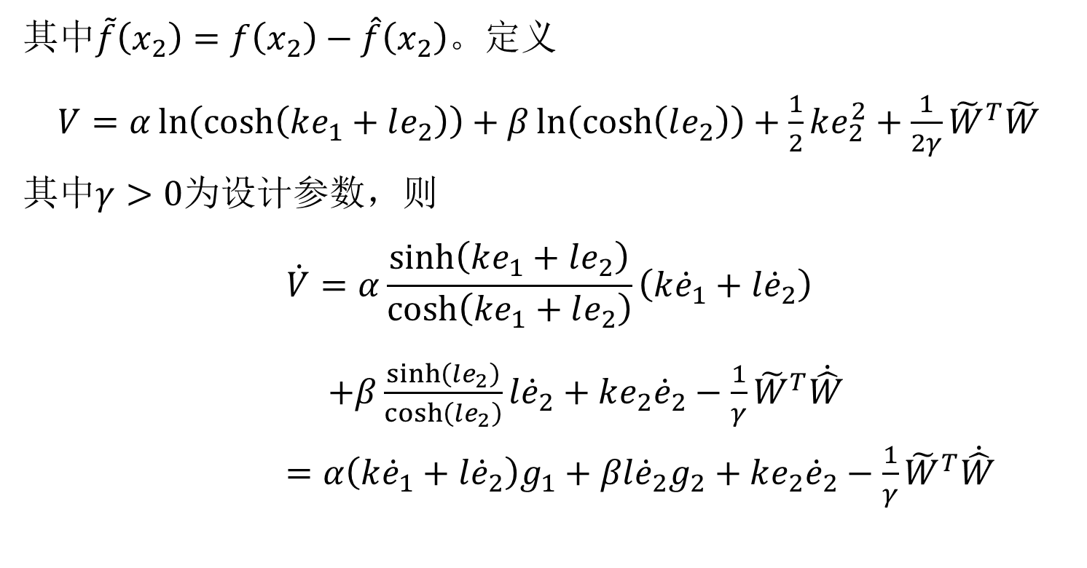
其中$\tilde{f}\left(x_{2}\right)=f\left(x_{2}\right)−\hat{f}\left(x_{2}\right)$。定义
$V=α\ln\left(\cosh\left(ke_{1}+le_{2}\right)\right)+β\ln\left(\cosh\left(le_{2}\right)\right)+\frac{1}{2}ke_{2}^{2}+\frac{1}{2γ}{\tilde{W}}^{T}\tilde{W}$
其中$γ>0$为设计参数，则
$$\dot{V}=α\frac{\sinh\left(ke_{1}+le_{2}\right)}{\cosh\left(ke_{1}+le_{2}\right)}\left(k{\dot{e}}_{1}+l{\dot{e}}_{2}\right)$$
$+β\frac{\sinh\left(le_{2}\right)}{\cosh\left(le_{2}\right)}l{\dot{e}}_{2}+ke_{2}{\dot{e}}_{2}−\frac{1}{γ}{\tilde{W}}^{T}\dot{\hat{W}}$ $=α\left(k{\dot{e}}_{1}+l{\dot{e}}_{2}\right)g_{1}+βl{\dot{e}}_{2}g_{2}+ke_{2}{\dot{e}}_{2}−\frac{1}{γ}{\tilde{W}}^{T}\dot{\hat{W}}$

Slide 11

$$=α\left(ke_{2}+l\left(−αg_{1}−βg_{2}+\tilde{f}\left(x_{2}\right)−ρsgn(αlg_{1}+βlg_{2}+ke_{2})\right)\right)g_{1}$$
$$+βl\left(−αg_{1}−βg_{2}+\tilde{f}\left(x_{2}\right)−ρsgn(αlg_{1}+βlg_{2}+ke_{2})\right)g_{2}$$
$$+ke_{2}\left(−αg_{1}−βg_{2}+\tilde{f}\left(x_{2}\right)−ρsgn(αlg_{1}+βlg_{2}+ke_{2})\right)−\frac{1}{γ}{\tilde{W}}^{T}\dot{\hat{W}}$$

Slide 12
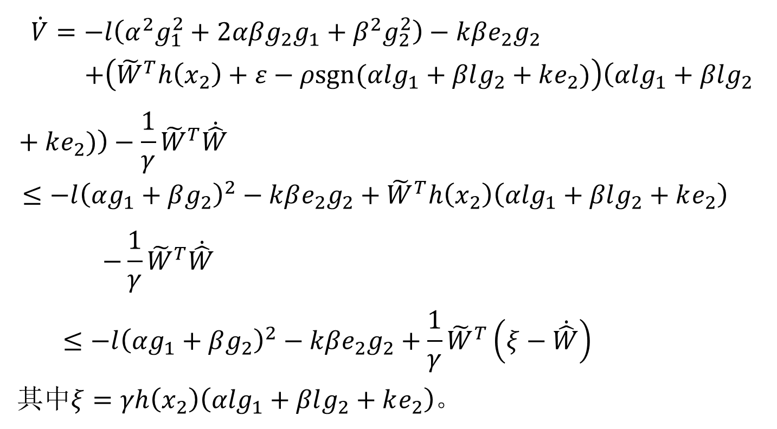
$$\dot{V}=−l\left(α^{2}g_{1}^{2}+2αβg_{2}g_{1}+β^{2}g_{2}^{2}\right)−kβe_{2}g_{2}$$
$$+\left({\tilde{W}}^{T}h\left(x_{2}\right)+ε−ρsgn(αlg_{1}+βlg_{2}+ke_{2})\right)\left(αlg_{1}+βlg_{2 }+ke_{2})\right)−\frac{1}{γ}{\tilde{W}}^{T}\dot{\hat{W}}$$
$$≤−l{\left(αg_{1}+βg_{2}\right)}^{2}−kβe_{2}g_{2}+{\tilde{W}}^{T}h\left(x_{2}\right)\left(αlg_{1}+βlg_{2}+ke_{2}\right)$$
$$−\frac{1}{γ}{\tilde{W}}^{T}\dot{\hat{W}}$$
$$≤−l{\left(αg_{1}+βg_{2}\right)}^{2}−kβe_{2}g_{2}+\frac{1}{γ}{\tilde{W}}^{T}\left(ξ−\dot{\hat{W}}\right)$$
其中$ξ=γh\left(x_{2}\right)\left(αlg_{1}+βlg_{2}+ke_{2}\right)$。

Slide 13
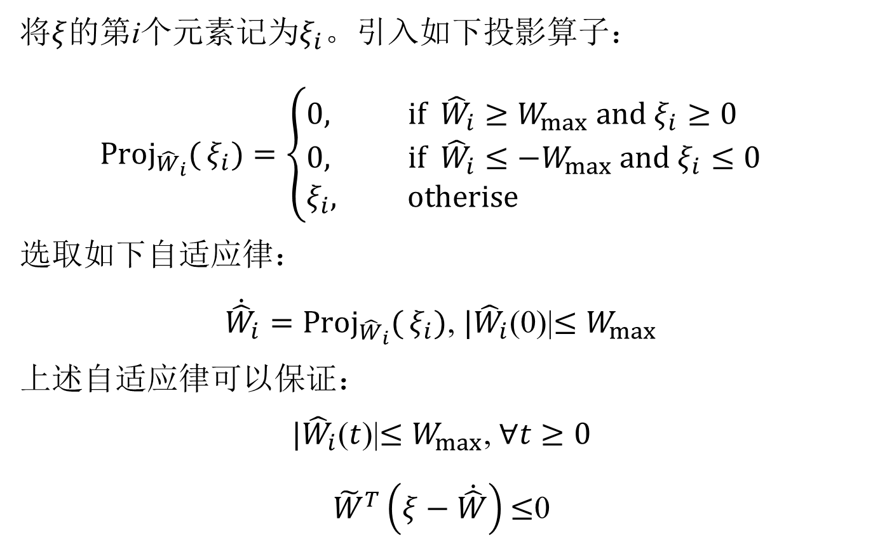
将$ξ$的第i个元素记为$ξ_{i}。$引入如下投影算子：
$${Proj}_{{\hat{W}}_{i}}{(}ξ_{i})=\left\{\begin{aligned}&0​, \text{if} {\hat{W}}_{i}≥{W_{max} \text{and} ξ_{i}≥0}_{} \\ &0, \text{if} {\hat{W}}_{i}≤{−W_{max} \text{and} ξ_{i}≤0}_{} \\ &ξ_{i}\text{, }\text{otherise}\end{aligned}\right.$$
选取如下自适应律：
${\dot{\hat{W}}}_{i}={Proj}_{{\hat{W}}_{i}}{(}ξ_{i})$, ${|\hat{W}}_{i}$(0)|$≤W_{max}$
上述自适应律可以保证：
${|\hat{W}}_{i}$($t$)|$≤W_{max}$, $∀t≥0$
${\tilde{W}}^{T}\left(ξ−\dot{\hat{W}}\right)$ $≤$0

Slide 14
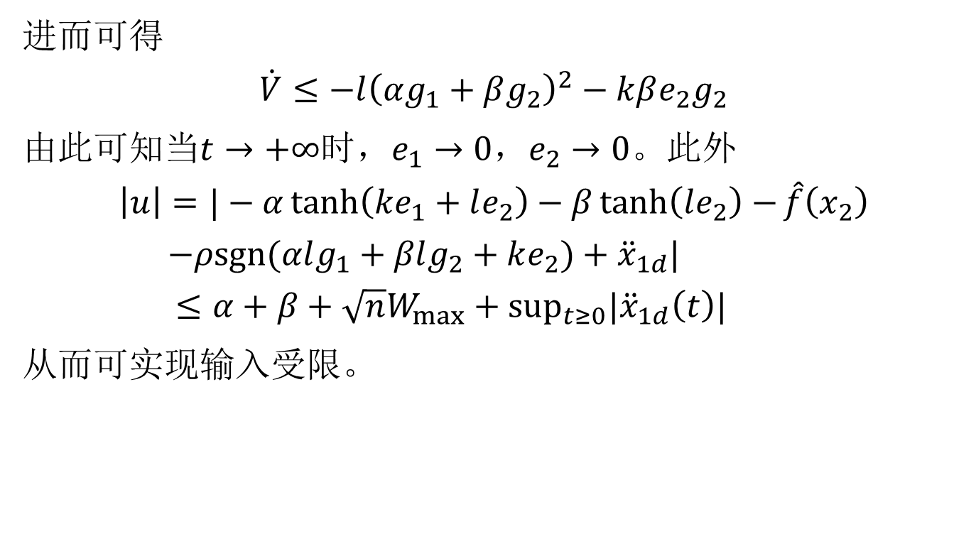
进而可得
$$\dot{V}≤−l{\left(αg_{1}+βg_{2}\right)}^{2}−kβe_{2}g_{2}$$
由此可知当$t→+∞$时，$e_{1}→0$，$e_{2}→0。$此外
$$\left|u\right|=|−α\tanh\left(ke_{1}+le_{2}\right)−β\tanh\left(le_{2}\right)−\hat{f}\left(x_{2}\right)$$
$$−ρsgn(αlg_{1}+βlg_{2}+ke_{2})+{\ddot{x}}_{1d}|$$
$$≤α+β+\sqrt{n}W_{max}+\sup_{t≥0}{|\ddot{x}}_{1d}\left(t\right)|$$
从而可实现输入受限。

